Slide 1
Tableau CitiBike Assignment
File created on: 5/28/2021 6:51:02 PM

Slide 2
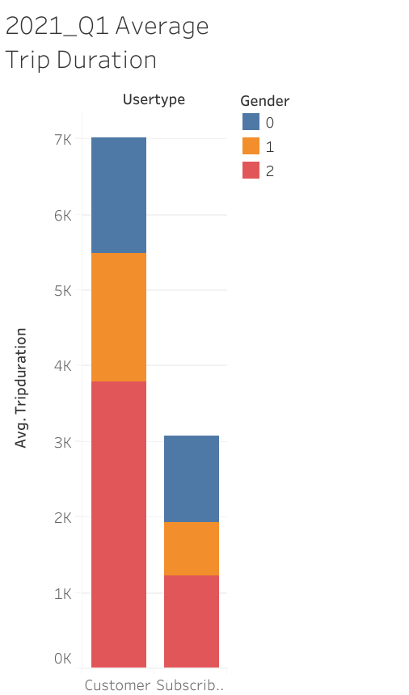
Trip Durations/Distance
(Phenomena #1)
Looking at the average trip duration by known gender and user type for the first quarter of 2021 ;
The trip duration for customers is more than double comparing to subscribers.
The average trip duration for known female riders is larger comparing to males and the unknown compined.

Slide 3
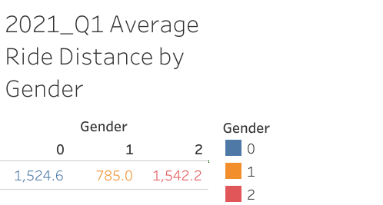
Trip Durations/Distance
(Phenomena #1)
According to the data, females are more likely to use the bike for longer distance, on average.

Slide 4
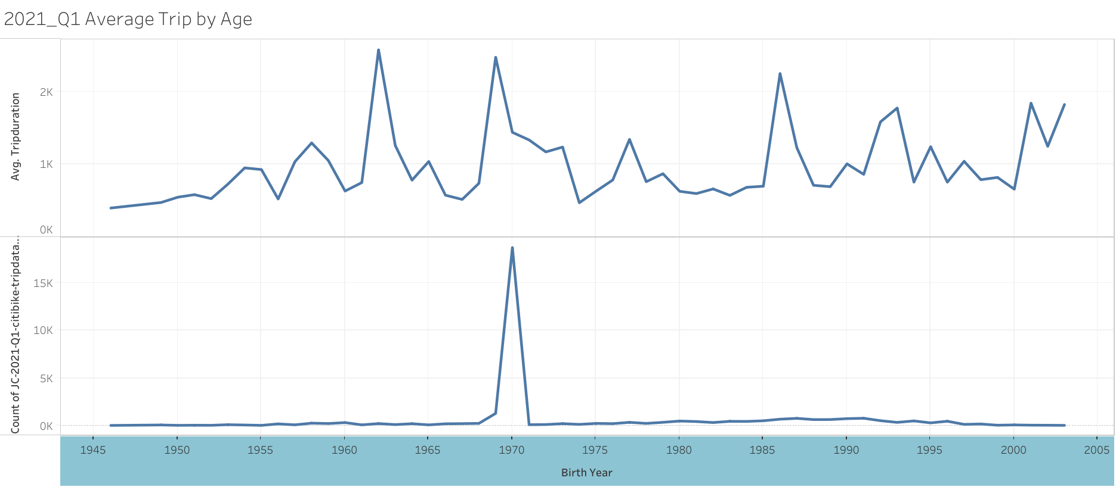
Average Trip by Age
It appears that heavily users are riders born during late 1960’s and early 1970’s.

Slide 5
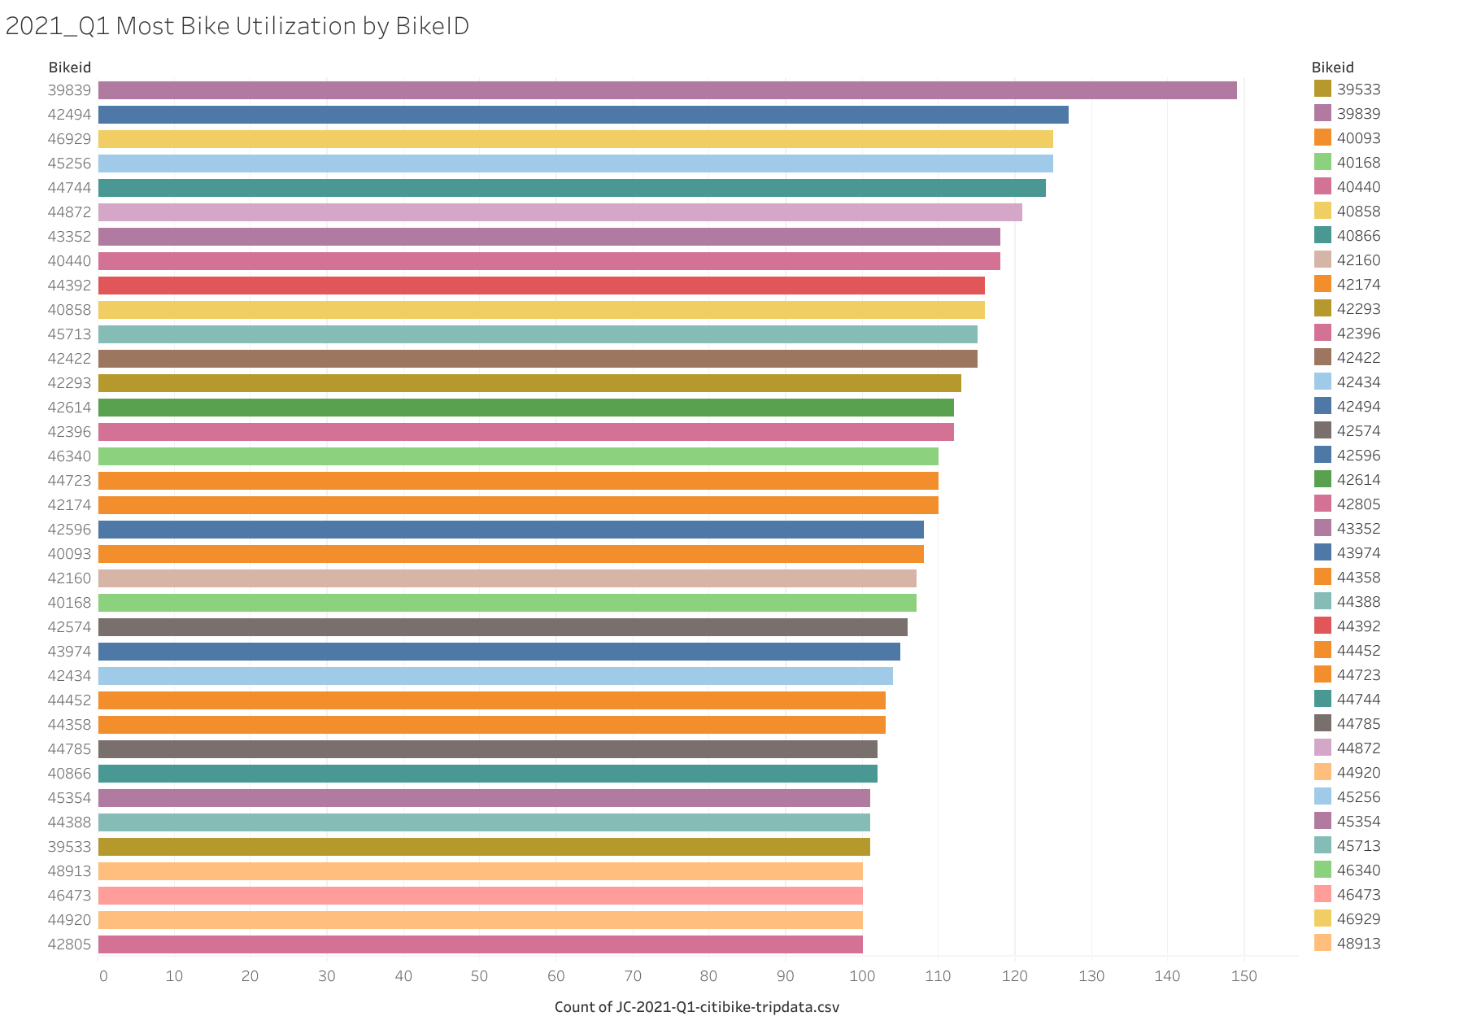

Slide 6
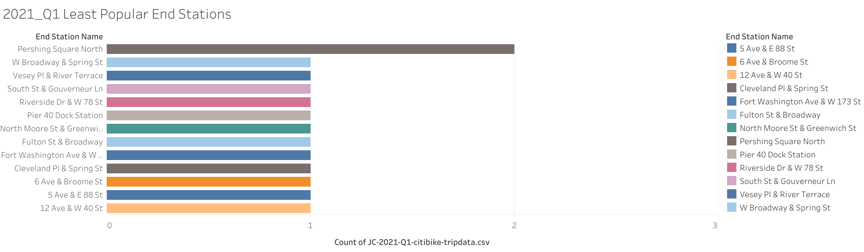

Slide 7
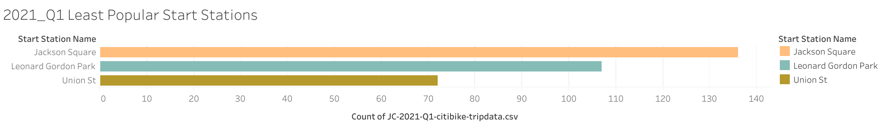

Slide 8
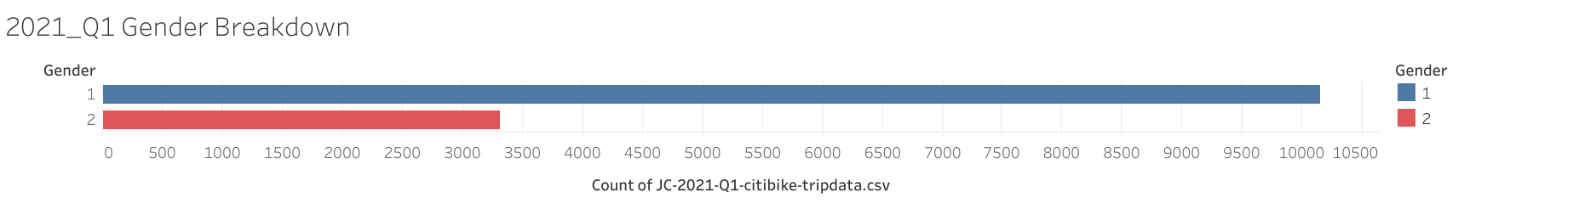

Slide 9
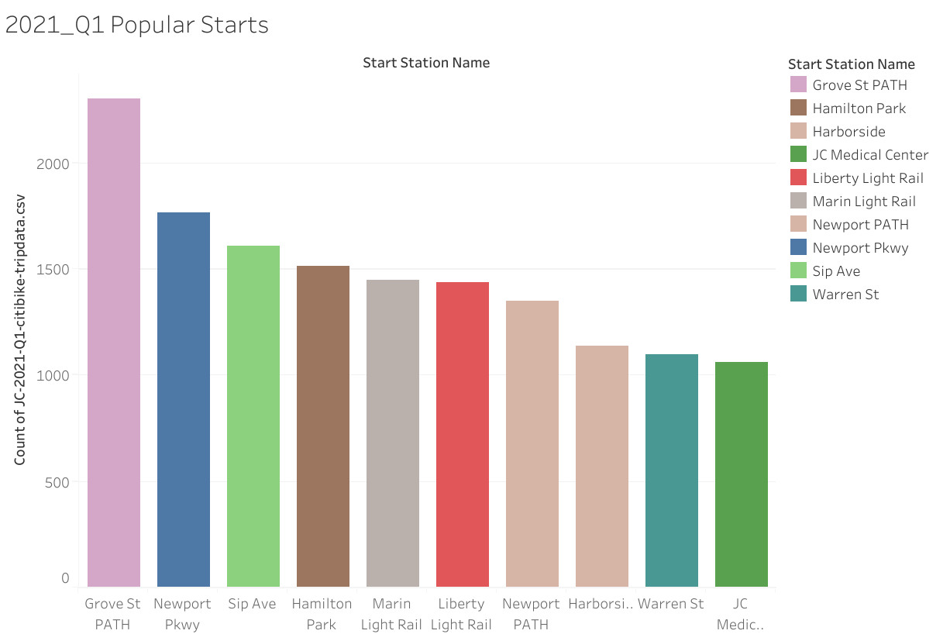

Slide 10
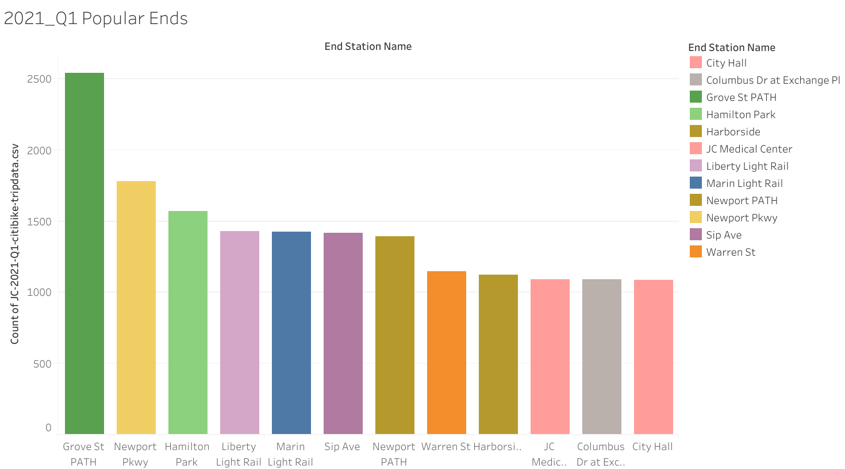

Slide 11
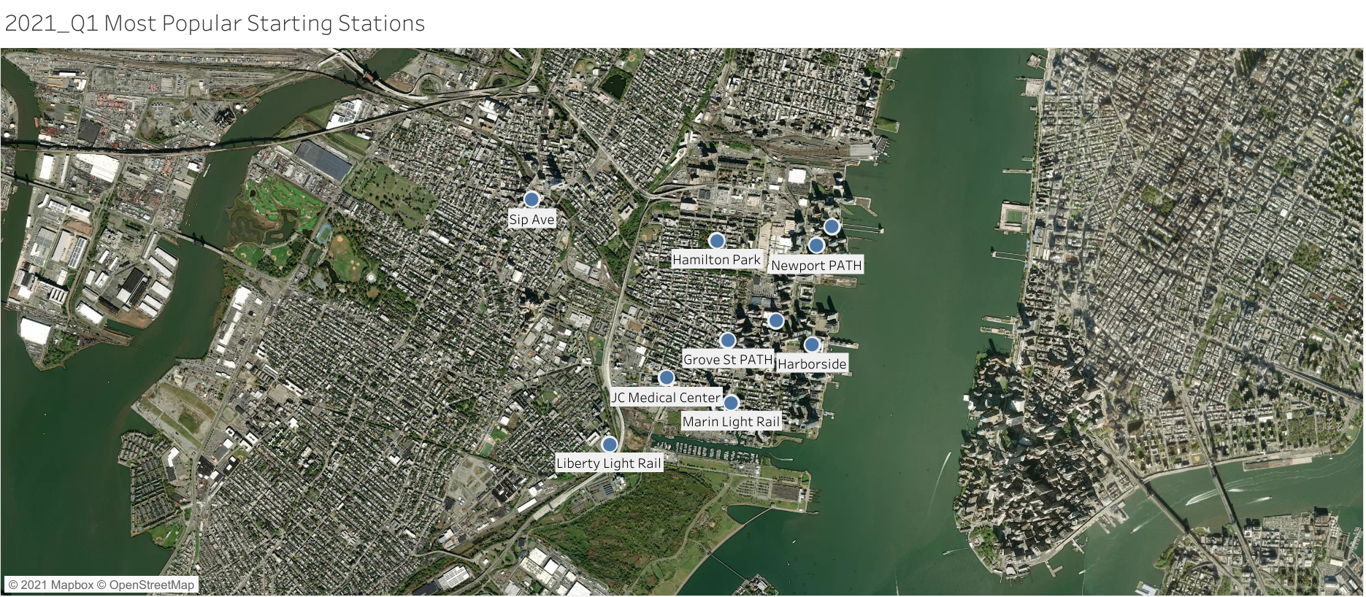

Slide 12
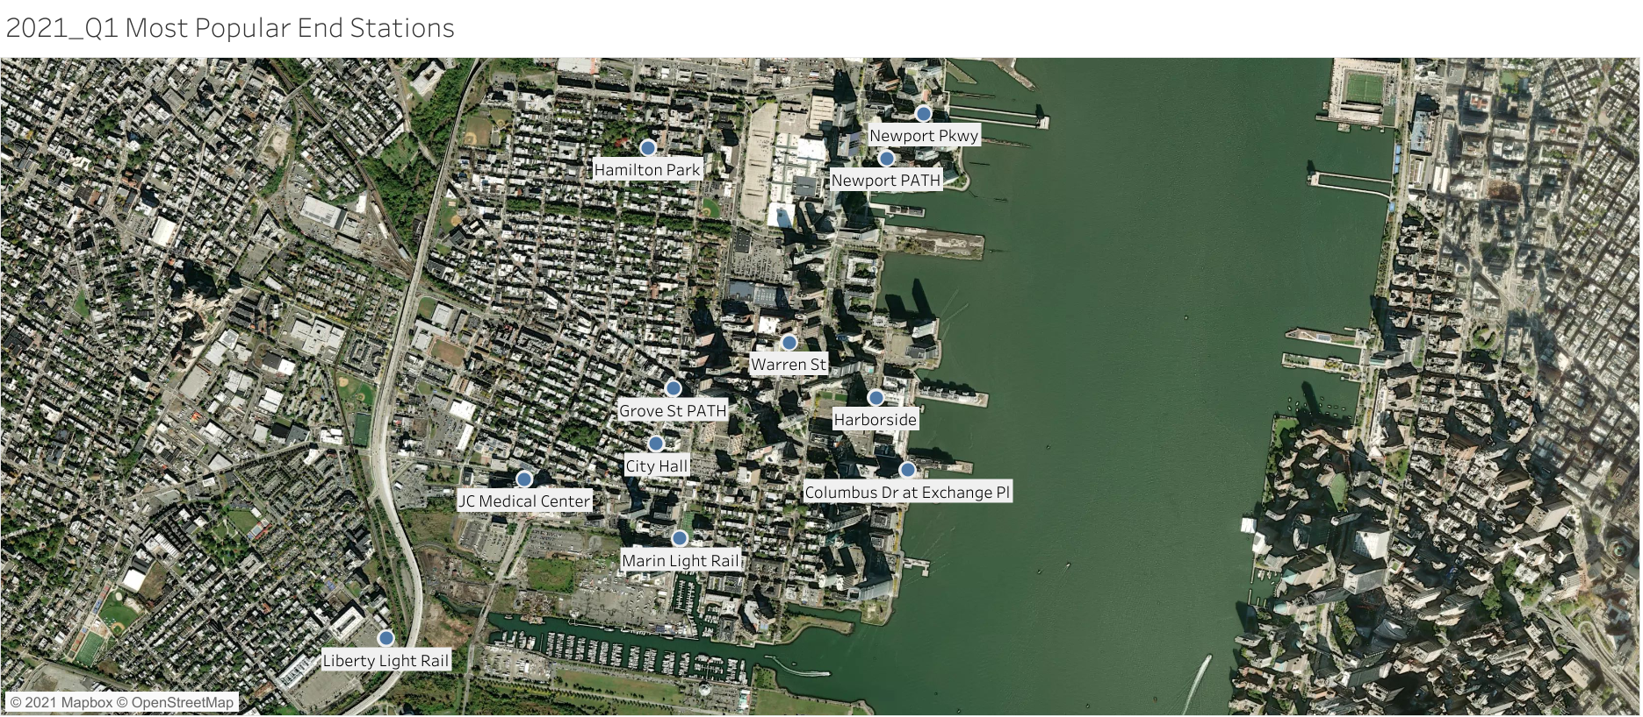

Slide 13
